Slide 1
A Novel Method Cross-Modal Retrieval
Reporter: Zhang Chaofeng
Major: Software Engineering

Slide 2
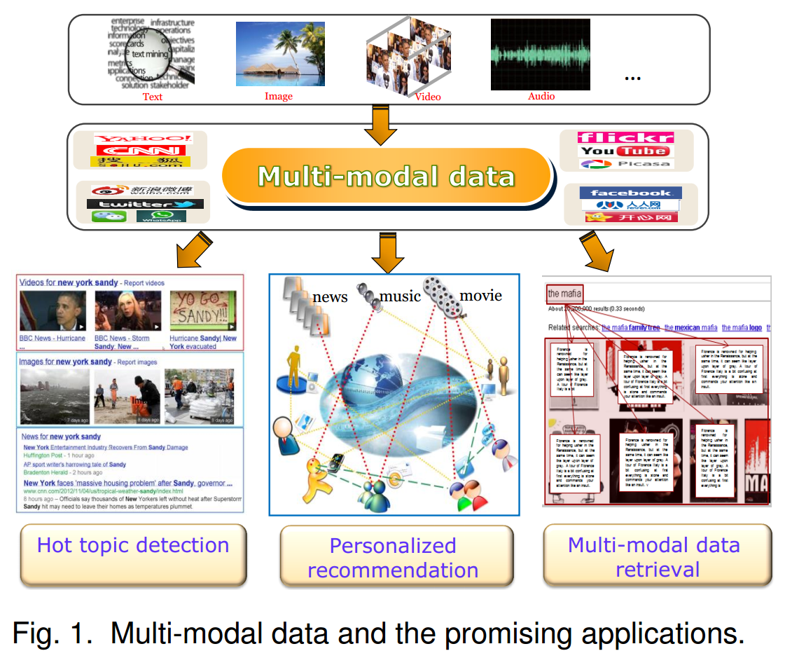




Multi-Modal data
Hot topic detection
Personalized
recommendation
Multi-modal data retrieval

Slide 3
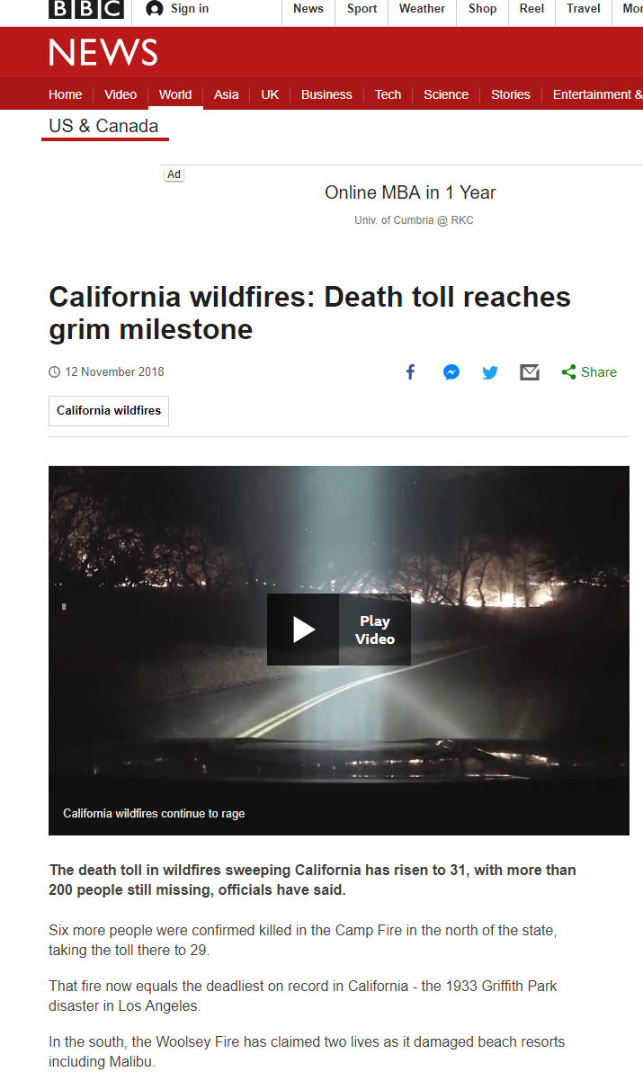
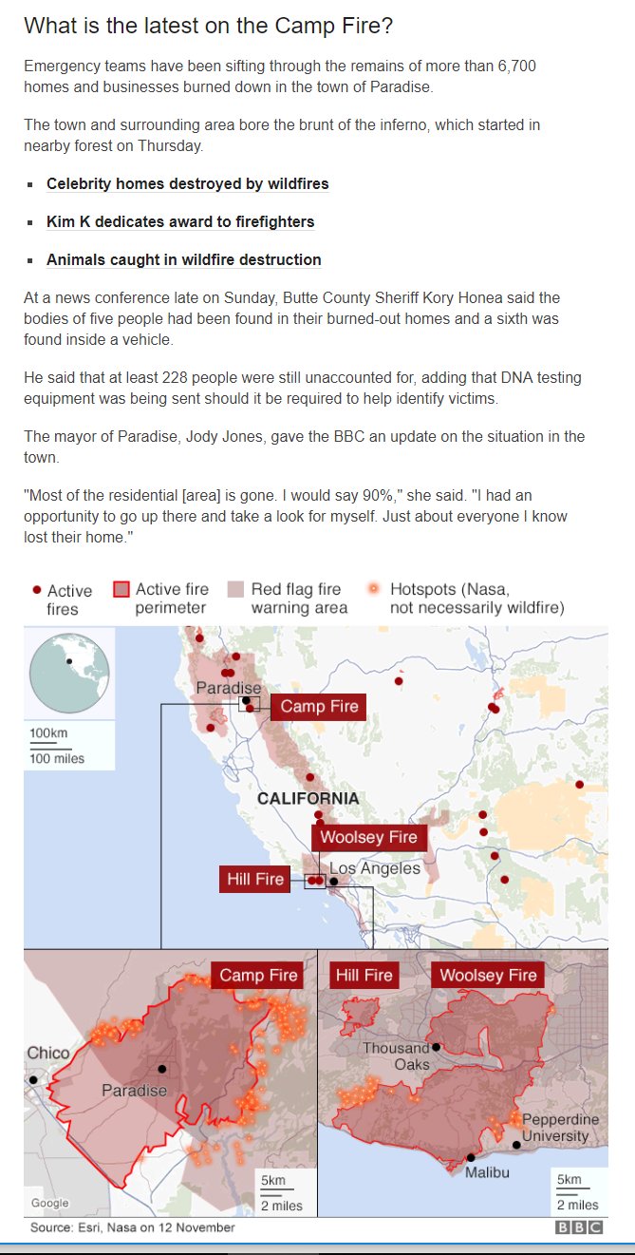


Slide 4
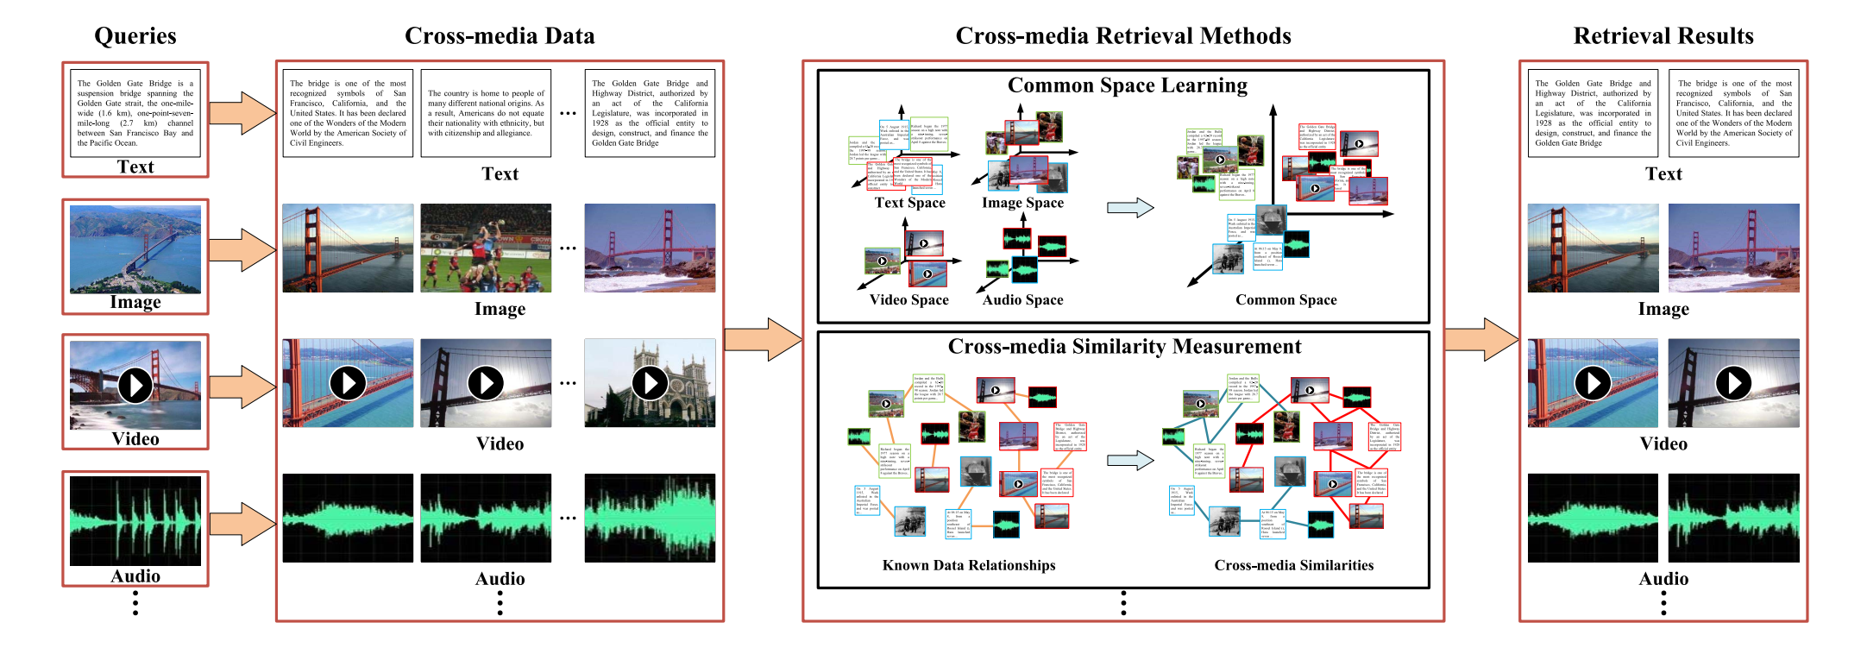
A brief illustration of Cross-Media Retrieval
Queries
Cross-media data
Cross-media retrieval Methods
Retrieval Results

Slide 5
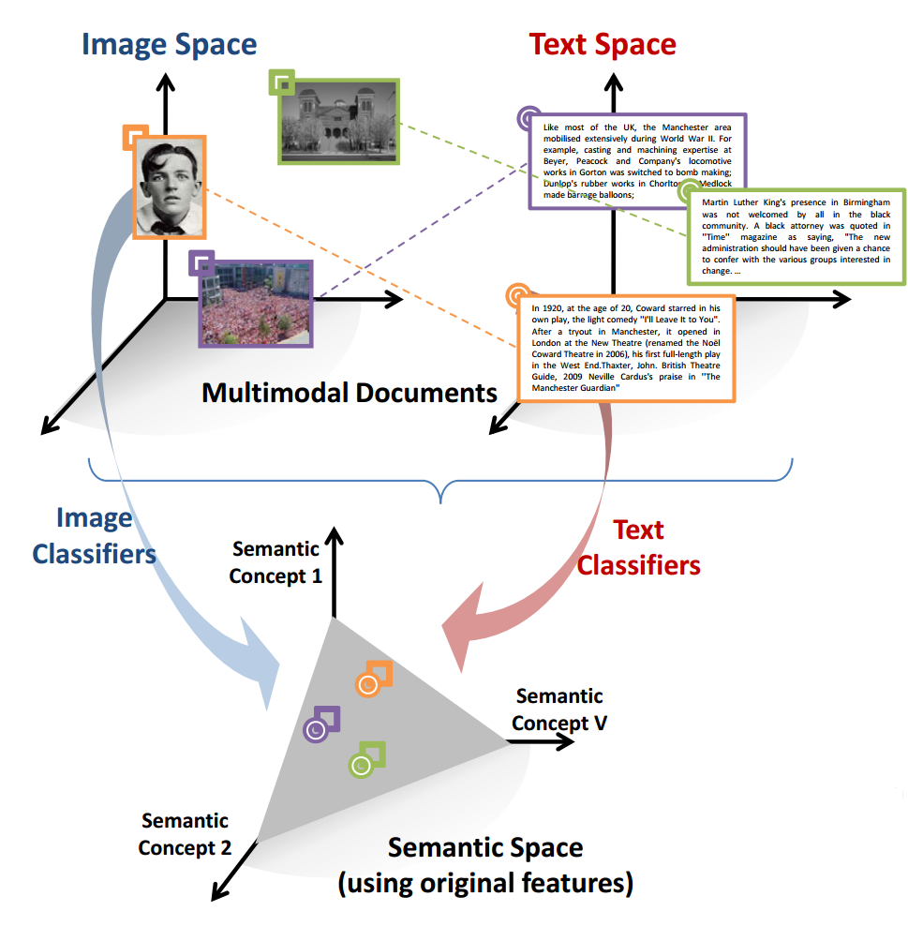
The Key Challenge："media gap"
Mapping of the text and image from their respective natural spaces to Semantic Space

Slide 6
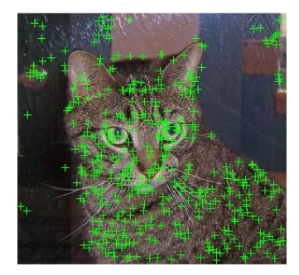
First Problem : noises
background noises may aﬀect the retrieval

Slide 7
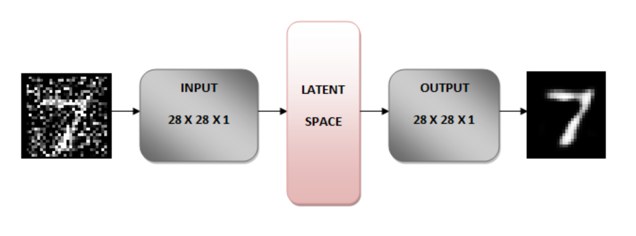
Denoising Autoencoders（降噪自编码器）
input
output
Latent Space
denoising the noisy images

Slide 8
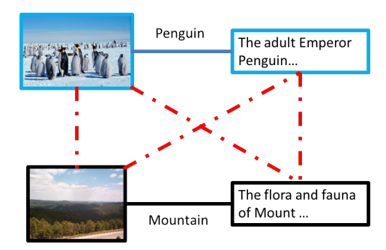
Second Problems : similarity metric
the relationships represented by the dotted lines are not considered in most other methods

Slide 9
a new similarity for
illustrate the relationships
pairwise similarity distances
(blue and black),↓
Heterogeneous（异质）↑
similarity distances (yellow),
Homogeneous（同质）↑
similarity distances (red).

Slide 10

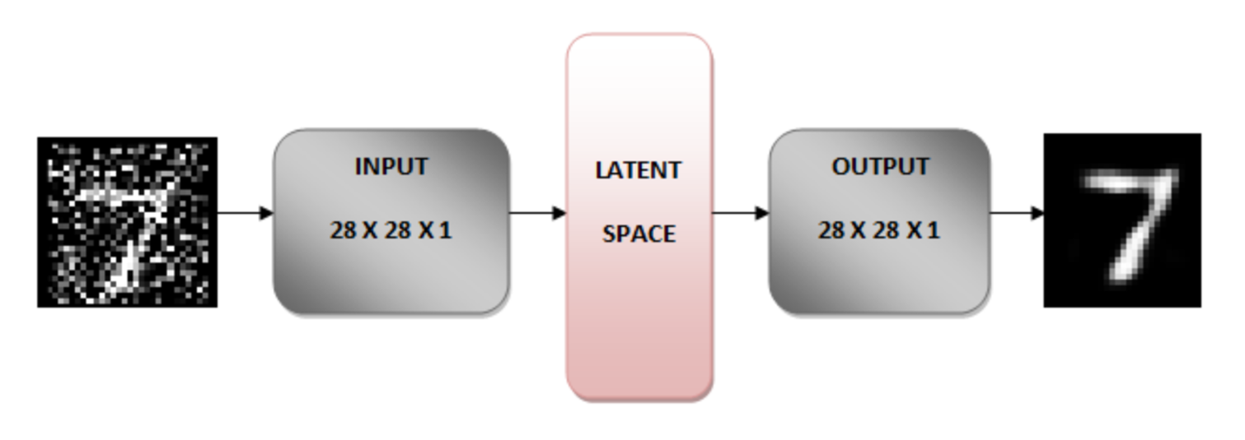
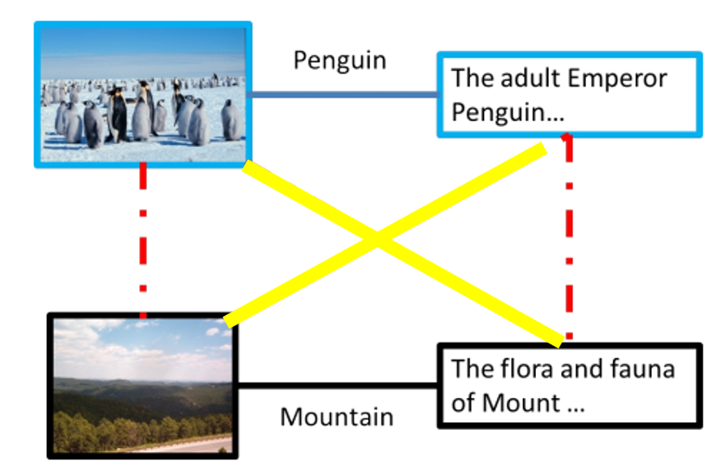
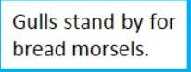
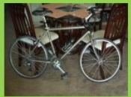
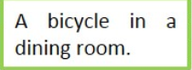
A Novel Method
Extract features
Calculate similarity
Image Features
Word Features
Image Features
SGD (随机梯度下降) algorithm
Word Features
Denoising Autoencoders

Slide 11
Thank you

